Slide 1
Digital Logic Design and Application
Lecture #04
Standard representations of logic functions

Slide 2
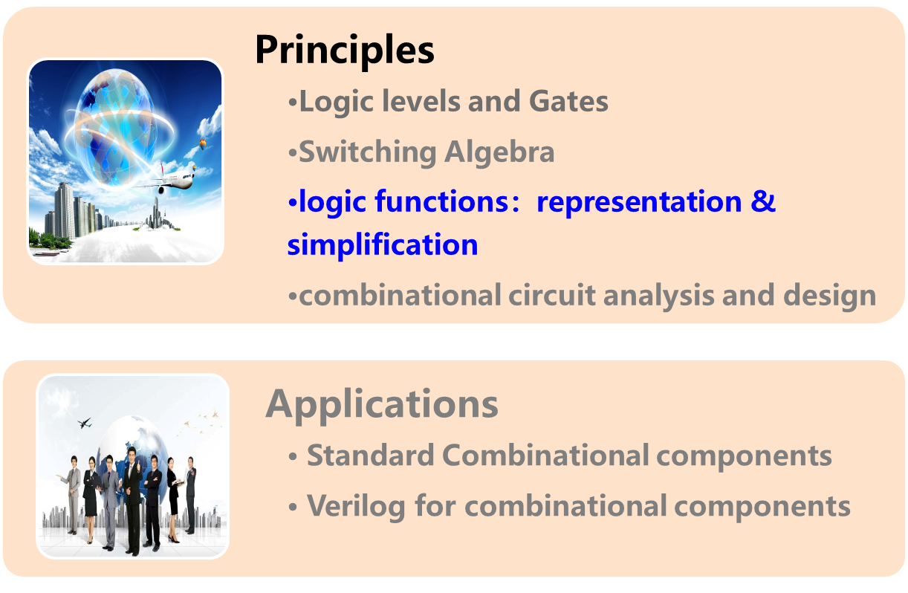
Topic 2-1 combinational circuits design

Slide 3
Logic Function and its Representations
the weight lifting referee circuit
Truth Table
C
Switch ABC: 1-on（close）
LED Y: 1-light
A
B
C
Y
A
0 0 0
0 0 1
0 1 0
0 1 1
1 0 0
1 0 1
1 1 0
1 1 1
0
0
0
0
0
1
1
1
B
Y
Logic Equation
Y = F (A,B,C ) = A·(B+C)
A
B
Y
C
Logic Circuit

Slide 4
Logic Function and its Representations
Truth table
  One function ↔ one truth table
Logic Function/ Equation
  Non-unique
Logic circuit
  Non-unique
Eg. Y = A·(B+C)
= A·B+A·C

Slide 5
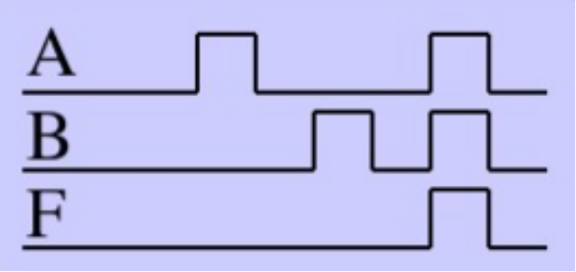
Logic Function and its Representations
Other representations
  Waveform chart
    Unique
    Waveform truth table
  Hardware Description
    Non-unique
      Behavioral/dataflow/structural
Eg. F (A,B) = A·B

Slide 6
Logic Function and its Representations
Some definitions
normal term（标准/规范项）： a product term or a sum term, where no variables，including complements of variables, appear more than once.
N-variable Minterm（最小项）：a normal product term with n variable, there’re 2^{n} Minterms
N-variable Maxterm（最大项）： a normal sum term with n variable, there’re 2^{n} Maxterms.
A·B·A’ ，A’+B+B
2-variable ：A·B，A’·B，A· B’，A’·B’
2-variable ： A+B ， A’+B，A+ B’， A’+B’

Slide 7

Logic Function and its Representations
F (A,B ) = A’·B+A
Sum-of-Products
积之和(SOP)
→F (A,B ) = A’·B+A·B+A·B’
G (A,B ) = A’ ·(A+B’)
→G (A,B ) = (A’+B·B’) ·(A+B’)
=(A’+B)(A’+B’)(A+B’)
Product-of-Sums
和之积(POS)
applying
P38 12b
Arbitrary terms can represented by normal terms.
Arbitrary logic function can be represented by Maxterms and Minterms.

Slide 8
Standard Representations of Logic Functions
Minterm
There are 2^{n} such product terms.
The sum of all minterms is 1.
The product of any two different product-terms is 0.
Every input combination can make one and only one Minterm=1.
A
B
C
Miniterm
0 0 0
0 0 1
0 1 0
0 1 1
1 0 0
1 0 1
1 1 0
1 1 1
m₀
m₁
m₂
m₃
m₄
m₅
m₆
m₇
A’·B’·C’
A’·B’·C
A’·B ·C’
A’·B·C
A ·B’·C’
A ·B’·C
A ·B ·C’
A ·B ·C
(1,0,0) → m₄=A·B’·C’=1
1 → variable
0 → (variable)’
Notes:
The subscript of each Minterm indicates the input binary combination makes this Minterm=1.

Slide 9
Standard Representations of Logic Functions
Maxterms
There are 2^{n} such sum terms.
The product of all Maxterms is 0.
The sum of any two different sum-terms is 1.
m_{i} = (M_{i})’
Every input combination can make one and only one Maxterm=0.
A
B
C
Maxterm
0 0 0
0 0 1
0 1 0
0 1 1
1 0 0
1 0 1
1 1 0
1 1 1
A+B+C
A+B+C’
A+B’+C
A+B’+C’
A’+B+C
A’+B+C’
A’+B’+C
A’+B’+C’
M₀
M₁
M₂
M₃
M₄
M₅
M₆
M₇
(0,0,1) → M₁=A+B+C’=0
0 → variable
1 → (variable)’
Notes:
The subscript of each Maxterm indicates the input binary combination makes this Maxterm=0.

Slide 10
Canonical forms of Logic Functions
A logic function can be represented by both canonical sum and canonical product.
Canonical Sum（标准和）
  equals the Sum-of-the-Minterms (a.k.a SOP) corresponding to truth-table rows which produce a 1 output.
Canonical Product（标准积）
  equals the Product-of-the-Maxterms (a.k.a POS) corresponding to truth-table rows which produce a 0 output.

Slide 11
Standard Representations of Logic Functions
——from truth table to logic functions
Example 2
F = + +
A’·B·C A·B’·C A·B·C’
A
B
C
F
Canonical Sum（标准和）
=Sum of Minterms
m₀
m₁
m₂
m₃
m₄
m₅
m₆
m₇
0 0 0 0
0 0 1 0
0 1 0 0
0 1 1 1
1 0 0 0
1 0 1 1
1 1 0 1
1 1 1 0
M₀
M₁
M₂
M₃
M₄
M₅
M₆
M₇
= Σ_{A,B,C}(3,5,6)
Minterm list
Labels
complement
= Π_{A,B,C}(0,1,2,4,7)
Maxterm list
(A+B+C) (A’+B’+C’)
F = · ……·
Canonical Product（标准积）
=Product of Maxterms
Notes:
Use the fact that only one input combination can make a single Min=1 or Max=0 to complete the standard representations of logic functions.
F=1 when arbitrary minterm=1; F=0 when arbitarary Maxterm=0. So F= sum-of-minterms or product-of-maxterms.

Slide 12
Standard Representations of Logic Functions
——from truth table to logic functions
Minterm list is also known as the on-set for each minterm “turns on” the output for exactly one input combination.
Maxterm list is also known as the off-set for each maxterm “turns off” the output for one input combination.
F =A’·B·C+A·B’·C+A·B·C’
=Σ_{A,B,C}(3,5,6)
F =(A+B+C)·(A’+B+C)·(A’+B’+C’)
= Π_{A,B,C}(0,4,7)

Slide 13

Basic Operation of Logic Function
Complement function
Example 4
Labels complement
A
B
C
F
F’
0
1
2
3
4
5
6
7
0 0 0 0
0 0 1 0
0 1 0 0
0 1 1 1
1 0 0 0
1 0 1 1
1 1 0 1
1 1 1 0
1
1
1
0
1
0
0
1
F = Σ _{A,B,C} (3,5,6)
= Π _{A,B,C} (0,1,2,4,7)
Same
label
F’= Π _{A,B,C} (3,5,6)

Slide 14
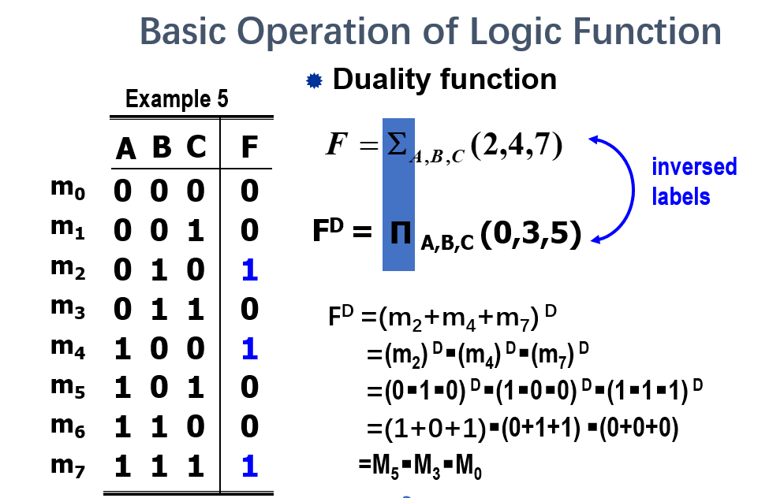

Slide 15
Basic Operation of Logic Function
Example 6：
F1 = Σ_{(A,B,C,D)} ( 1, 5, 7, 9, 13 )
F2 = Σ_{(A,B,C,D)} ( 2, 6, 9, 13, 15 )
OR
AND
F = F1 + F2
= Σ_{(A,B,C,D)}(1,2,5,6,7,9,13,15)
F = F1 · F2 = Σ_{(A,B,C,D)} (9,13)
Notes:
Notice that F1 and F2 must compose by the same logic variables.

Slide 16
Summarise
The standard representations of a logic function
  Truth table
  Canonical sum—sum of Minterms.
  Canonical product—product of maxterms.
  Minterm list using notation of ∑.
  Maxterm list using notation of π.

